Slide 1
Molecular Programming
Luca Cardelli, Principal Researcher, MSR Cambridge Programming Principles and Tools
2012-12-06
Notes:
<Insert your notes here>
Tips for your title slide (single presenter)
Presentation title
Segoe Semibold 40, title caps
Begin the title with the topic, followed by the focus area (for example, Eggs: How to Cook Them, rather than How to Cook Eggs). This title structure is more useful in catalogs and Web searches, and it helps customers find related information and resources on a given topic in alpha lists.
Avoid starting a title with words like "A" or "The."
Subtitle field
Segoe 28, title caps
If this talk is part of a series, use this field to represent the series.
Not all slide decks will require the subtitle field; delete the text box if you don't need it.
Presenter's information
First and last name
Segoe 24, no bold, title caps
Example: Nina Vietzen, Editor, Office
Date of presentation
Segoe 18
Use this format: November 2005. For the most part, the day is not of importance. If the day is important, use the
Month Day, Year format. For example: July 21, 2007
Do not use an all-number method to refer to the date. Remember, your audience is global and therefore has different interpretations of numeric date formats.

Slide 2
Objectives
The promises of Molecular Programming:
In Science & Medicine
In Engineering
In Computing
The current practice of Molecular Programming
DNA technology
Molecular languages and tools
Example of a molecular algorithm
Notes:
<Insert your notes here>
Content tips about objectives
An objective is a clear statement of what the learner will be able to do after the presentation is complete. Objectives contain action verbs, standards of performance, and conditions. Examples:
Identify (action verb) all five (standard of performance) critical attributes of a focus group from memory (condition).
Given 10 market situations (condition), compare (action verb) five market research tools and choose (action verb) the one best suited to each situation. Eight out of 10 of your answers must match that of our expert market research panel (standard of performance).
Examples of good action verbs: define, state, summarize, classify, explain, construct, analyze, justify, operate, assemble, demonstrate, construct, conduct, perform, present, produce.
Examples of action verbs to avoid (due to misinterpretation): understand, know, think, learn, enjoy, comprehend, grasp the significance of.
Delivery tips
Lead-in: "When you complete this presentation, you will be able to…"
Briefly describe each objective and tell attendees how they will benefit from attending your presentation.

Slide 3
The Hardware Argument
Smaller and smaller things can be built

Slide 4
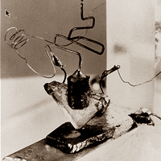
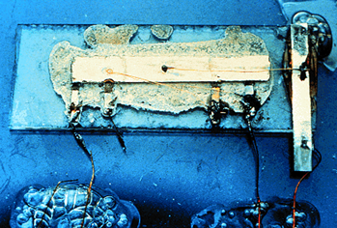
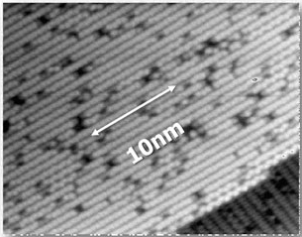
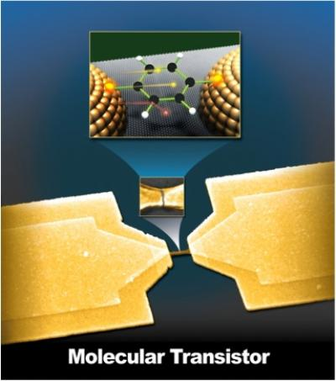
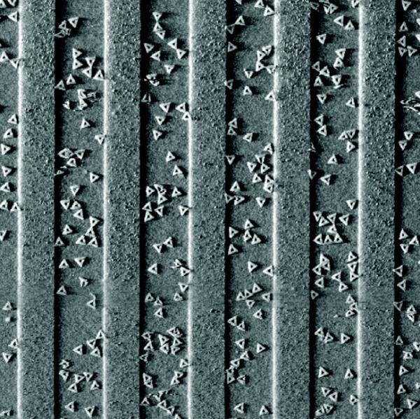
Smaller and Smaller
First working transistor John Bardeen and Walter Brattain , Dec. 23, 1947
First integrated circuit
Jack Kilby, Sep. 1958.
50 years later 25nm NAND flash
Intel&Micron, Jan. 2010. ~50atoms
Single molecule transistor Observation of molecular orbital gating Nature, 2009; 462 (7276): 1039
Molecules on a chip
~10 Moore’s Law cycles left!
Placement and orientation of individual DNA shapes on lithographically patterned surfaces. Nature Nanotechnology 4, 557 - 561 (2009).

Slide 5
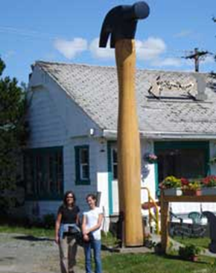
Building the Smallest Things
How do we build structures that are by definition smaller than your tools?
Basic answer: you can’t. Structures (and tools) should build themselves!
By programmed self-assembly
www.youtube.com/watch?v=Ey7Emmddf7Y

Slide 6
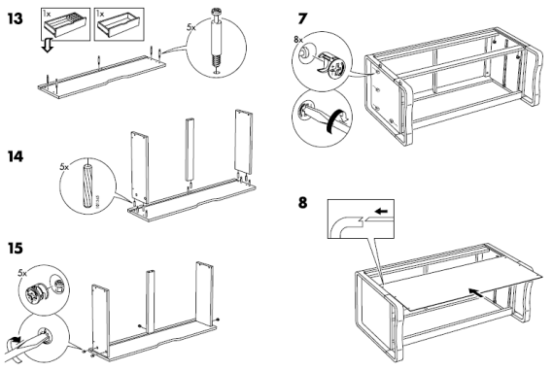
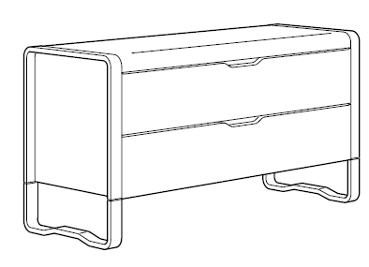
Molecular IKEA
Nature can self-assemble. Can we?
“Dear IKEA, please send me a chest of drawers that assembles itself.”
We need a magical material where the pieces are pre-programmed to fit into to each other.
At the molecular scale many such materials exist…
Add water
http://www.ikea.com/ms/en_US/customer_service/assembly_instructions.html

Slide 7
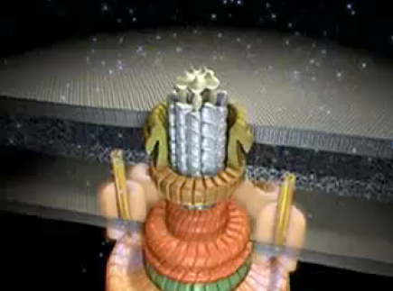
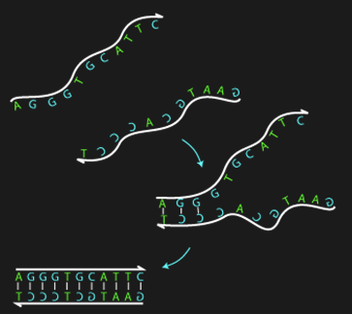
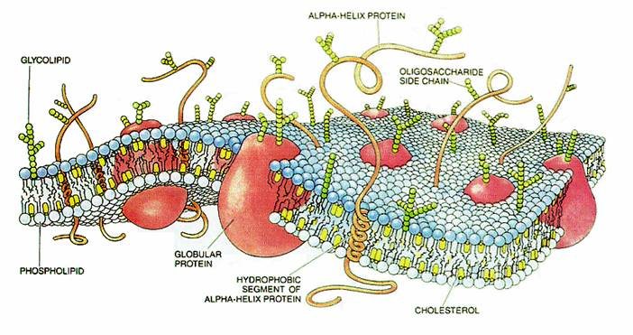
Programmed Self-Assembly
Proteins
DNA/RNA
Membranes
Wikimedia

Slide 8
The Software Argument
Smaller and smaller things can be programmed

Slide 9
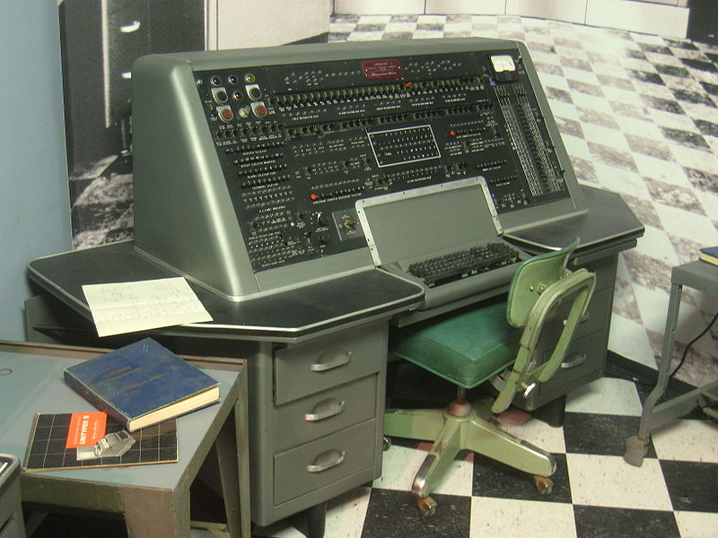
We can program...
Computers
Completely!
Information
Computing
Information

Slide 10
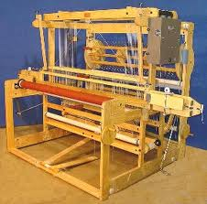
We can program...
Physical systems
Completely!
Modulo sensors/actuator capabilities
Sensing
Computing
Actuating

Slide 11
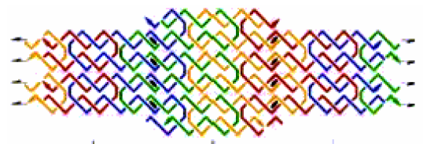
We can program...
Matter
Completely
Directly!
Which matter?
Currently: only DNA/RNA
But this is not so limiting...
Sensing
Computing
Constructing
Actuating

Slide 12
What can we do with it?
Organize ANY matter [caveats apply]
Execute ANY kinetics [caveats: up to time scaling]
Control molecular systems
Interface to Biology

Slide 13
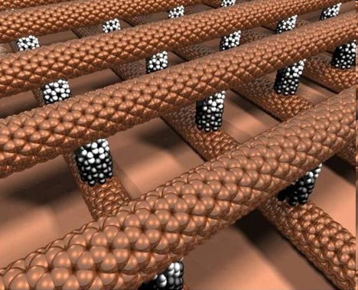
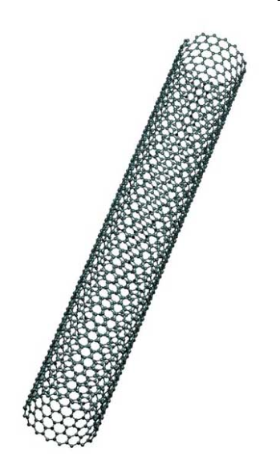
Organizing Any Matter
Use one kind of programmable matter (e.g. DNA)
To organize (almost) ANY matter through it
DNA-wrapped nanotubes
European Nanoelectronics Initiative Advisory Council
"What we are really making are tiny DNA circuit boards that will be used to assemble other components."
Greg Wallraff, IBM
+
6 nm grid of individually addressable DNA pixels
PWK Rothemund, Nature 440, 297 (2006)

Slide 14
Executing Any Desired Kinetics
The kinetics of any finite network of chemical reactions among abstract species, can be executed (physically) with especially programmed DNA molecules
Chemical reactions as an executable programming language for dynamical systems!

Slide 15
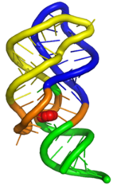
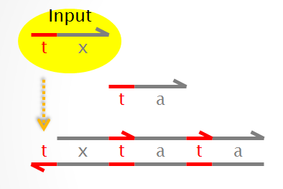
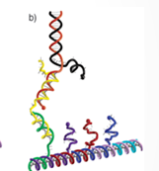
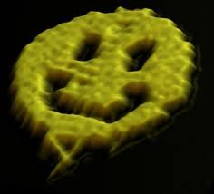
Building Molecular Controllers
All the components of nanocontrollers can already be built entirerly and solely with DNA, and interfaced to the environment.
DNA Aptamers
Sensing
Computing
DNA Logical Gates
Constructing
Actuating
Self-assembling DNA Tiles
DNA Walkers & Tweezers

Slide 16
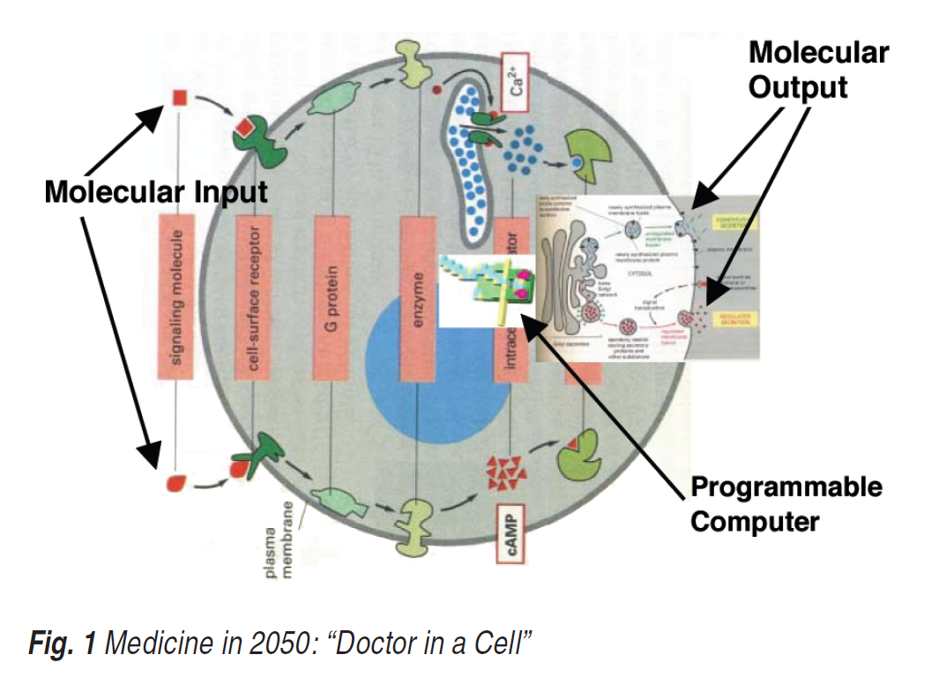
Interfacing to Biology
A doctor in each cell

Slide 17
The Biological Argument
Biological systems are already ‘molecularly programmed’

Slide 18
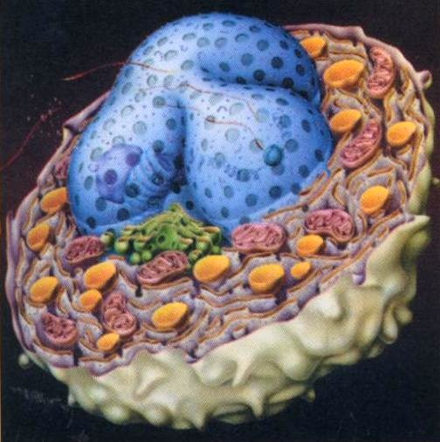
Abstract Machines of Biology
The “hardware” (biochemistry) is fairly well understood. But what is the “software” that runs on these machines?
Regulation
Gene Machine
Nucleotides
Functional Architecture Diverse - chemical toolkits - instruction sets - programming models - notations
Confine genome and regulators
Make proteins
Send signals
Direct construction
H.Lodish & al. Molecular Cell Biology 4th ed.
Model Integration
Different time and space scales
Hold receptors, host reactions
Protein Machine
Machine
Membrane
Aminoacids
Enact fusion, fission
Phospholipids
( )
Metabolism, Propulsion Signaling, Transport
Glycan Machine
Confinement, Storage Bulk Transport
Sugars
Surface and Extracellular Features

Slide 19
Languages
The “hardware” (biochemistry) is fairly well understood. But what is the “software” that runs on these machines?
Gene Networks
Gene Machine
Molecular Interaction Maps
Nucleotides
Functional Architecture Diverse - chemical toolkits - instruction sets - programming models - notations
Transport Networks
x
A
B
y
P
Q
C
Model Integration
Different time and space scales
Protein Machine
Machine
Membrane
Aminoacids
Phospholipids

Slide 20
But ...
Biology is programmable, but not by us!
Still work in progress:
Gene networks are being programmed in synthetic biology, but using existing ‘parts’
Protein networks are a good candidate, unfortunately we cannot yet effectively design proteins
Transport networks are being looked at for programming microfluidic devices manipulating vesicles

Slide 21
Molecular Languages
... that we can deal with

Slide 22
Long-Term Action Plan
Building a full pipeline
Mathematical Foundations [~ concurrency theory in the 80’s]
Programming Languages [~ software engineering in the 70’s]
Analytical Methods and Tools [~ formal methods in the 90’s]
Device Architecture and Manufacturing [~ electronics in the 60’s]
Molecular Compilers
Front end: theory-backed analyzable programming languages
Back end: executable molecular systems
Requiring techniques for mastering complexity and analyzing system performance/safety ... mostly familiar to us
No “alien technology”!
Do not use components (from Biology) we do not understand how to build ourselves. [David Soloveichik]

Slide 23
Our Assembly Language: Chemistry
A Lingua Franca between Biology, Dynamical Systems, and Concurrent Languages
Chemical Reaction Networks
A + B →_{r} C + D (the program)
Ordinary Differential Equations
d[A]/dt = -r[A][B] … (the behavior)
Rich analytical techniques based on Calculus
But prone to combinatorial explosion
E.g., due to the peculiarities of protein interactions

Slide 24
Chemistry as a Concurrent Language
A connection with the theory of concurrency
Via Process Algebra and Petri Nets
Continuous-state Semantics (Mass Action Kinetics)
ODE
=
ODE
Continuous Chemistry
Process Algebra
Nondeterministic
Semantics
Combinatorial Explosion
Discrete Chemistry
Stochastic
Semantics
CTMC
=
CTMC
Discrete-state Semantics
(Chemical Master Equation)

Slide 25
How do we “run” Chemistry?
Chemistry is not easily executable
“Please Mr Chemist, execute me this bunch of reactions that I just made up”
Most molecular languages are not executable
They are descriptive (modeling) languages
How can we execute molecular languages?
With real molecules?
That we can design ourselves?
And that we can buy on the web?

Slide 26
Molecular Programming with DNA
Building the cores of programmable molecular controllers

Slide 27
DNA Computing
Non-goals
Not to solve NP-complete problems with large vats of DNA
Not to replace silicon
Bootstrapping a carbon-based technology
To precisely control the organization and dynamics of matter and information at the molecular level
DNA is our engineering material
Its biological origin is “accidental” (but convenient)
It is an information-bearing programmable material
It is possible that other such materials will be developed

Slide 28
Domains
Subsequences on a DNA strand are called domains
provided they are “independent” of each other
That is, differently named domains must not hybridize
With each other, with each other’s complement, with subsequences of each other, with concatenations of other domains (or their complements), etc.
Still somewhat of an open problem
A large literature
Can work in practice
Domain sequences often designed “by hand”
CTTGAGAATCGGATATTTCGGATCGCGATTAAATCAAATG
x
y
z

Slide 29
Short Domains
t
t
t
Reversible Hybridization

Slide 30
Long Domains
x
x
x
Irreversible Hybridization

Slide 31
Strand Displacement
t
x
t
x
“Toehold Mediated”

Slide 32
Strand Displacement
t
x
Toehold Binding

Slide 33
Strand Displacement
t
x
Branch Migration

Slide 34
Strand Displacement
t
x
Displacement

Slide 35
Strand Displacement
x
t
x
Irreversible release

Slide 36
Bad Match
t
x
z
t
x
y

Slide 37
Bad Match
z
x
t
x
y

Slide 38
Bad Match
z
x
t
x
y

Slide 39
Bad Match
z
t
x
y
Cannot proceed Hence will undo

Slide 40
Two-Domain Architecture
Signals: 1 toehold + 1 recognition region
Gates: “top-nicked double strands” with open toeholds
t
x
Garbage collection “built into” the gates
t
t
t
t
x
t
y
t
t
x
t
y
t
t
x
t
y
t
In S. B. Cooper, E. Kashefi, P. Panangaden (Eds.): Developments in Computational Models (DCM 2010). EPTCS 25, 2010, pp. 33-47. May 2010.

Slide 41
Transducer x→y
Input
t
x
t
a
y
t
t
x
t
a
t
a
x
t
y
t
a
t

Slide 42
Transducer x→y
Input
t
x
t
a
y
t
t
x
t
a
t
a
x
t
y
t
a
t
Built by self-assembly!
ta is a private signal (a different ‘a’ for each xy pair)

Slide 43
Transducer x→y
t
a
y
t
t
x
t
a
t
a
x
t
y
t
a
t

Slide 44
Transducer x→y
Active waste
x
t
t
a
y
t
t
x
t
a
t
a
x
t
y
t
a
t

Slide 45
Transducer x→y
x
t
y
t
t
x
t
a
t
a
x
t
y
t
a
t

Slide 46
Transducer x→y
x
t
a
t
y
t
t
x
t
a
t
a
x
t
y
t
a
t
So far, a tx signal has produced an at cosignal.
But we want signals as output, not cosignals.

Slide 47
Transducer x→y
x
t
y
t
t
x
t
a
t
a
x
t
y
t
a
t

Slide 48
Transducer x→y
x
t
t
a
y
t
t
x
t
a
t
a
x
t
y
a
t

Slide 49
Transducer x→y
x
t
t
a
t
x
t
a
t
a
x
t
y
t
a
t

Slide 50
Transducer x→y
x
t
t
a
Output
t
y
t
x
t
a
t
a
x
t
y
t
a
t
Here is our output ty signal.
But we are not done yet:
We need to make the output irreversible.
We need to remove the garbage.
We can use (2) to achieve (1).

Slide 51
Transducer x→y
x
t
t
a
Output
t
y
t
x
t
a
t
a
x
t
y
t
a
t

Slide 52
Transducer x→y
t
a
Output
t
y
t
x
t
a
t
a
x
t
y
t
a
t

Slide 53
Transducer x→y
x
t
a
Output
t
y
t
x
t
a
t
a
x
t
y
t
a
t

Slide 54
Transducer x→y
x
Output
t
y
t
x
t
a
t
a
x
t
y
t
a
t

Slide 55
Transducer x→y
a
x
Output
t
y
t
x
t
a
t
a
x
t
y
t
a
t

Slide 56
Transducer x→y
a
x
Output
t
y
t
x
t
a
t
a
x
t
y
t
a
t
Done.
N.B. the gate is consumed: it is the energy source

Slide 57
Transducer x→y

Slide 58
Join x+y→z

Slide 59
Tools and Techniques
A software pipeline for Molecular Programming

Slide 60
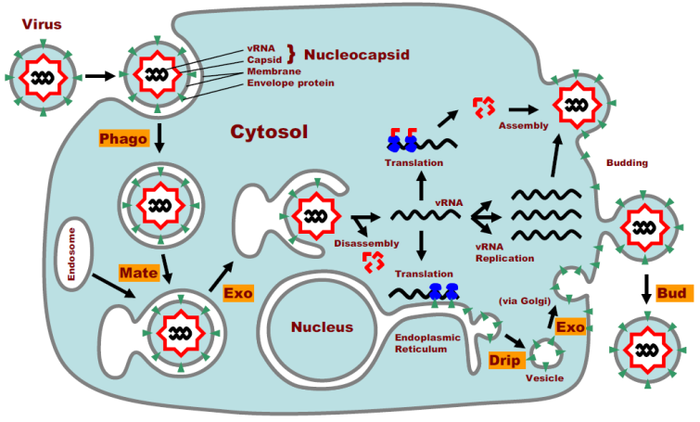
High(er)-Level Languages
Gene Networks
Synchronous Boolean networks
Stewart Kauffman, etc.
Asynchronous Boolean networks
René Thomas, etc.
Protein Networks
Process Algebra (stochastic π-calculus etc.)
Priami, Regev-Shapiro, etc.
Graph Rewriting (kappa, BioNetGen etc.)
Danos-Laneve, Fontana & al., etc.
Membrane Networks
Membrane Computing
Gheorghe Păun, etc.
Brane Calculi
Luca Cardelli, etc.
Waiting for an architecture to run on...

Slide 61
Molecular Compilation
“High-Level” Language
Programs
Boolean Networks
Petri Nets
Chemical Reaction Networks
Intermediate Language
Strand Algebra
…
Gates
DSD
Sequences
Architecture
4-domain Signals
3-domain Signals
2-domain Signals
Devices
Molecules

Slide 62
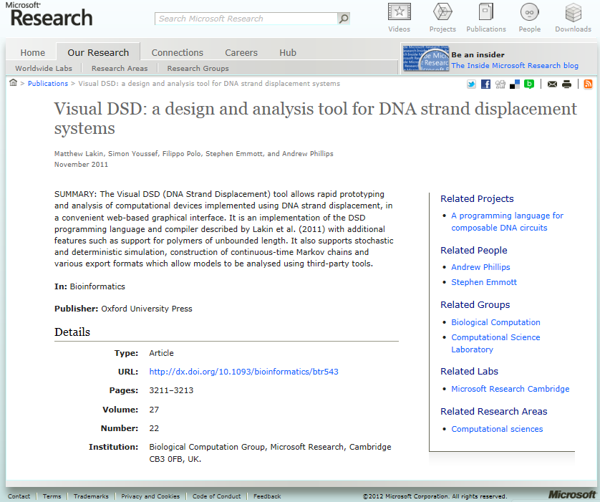
Visual DSD (DNA Strand Displacement)
http://research.microsoft.com/apps/pubs/default.aspx?id=157262 Andrew Phillips MSR Cambridge

Slide 63
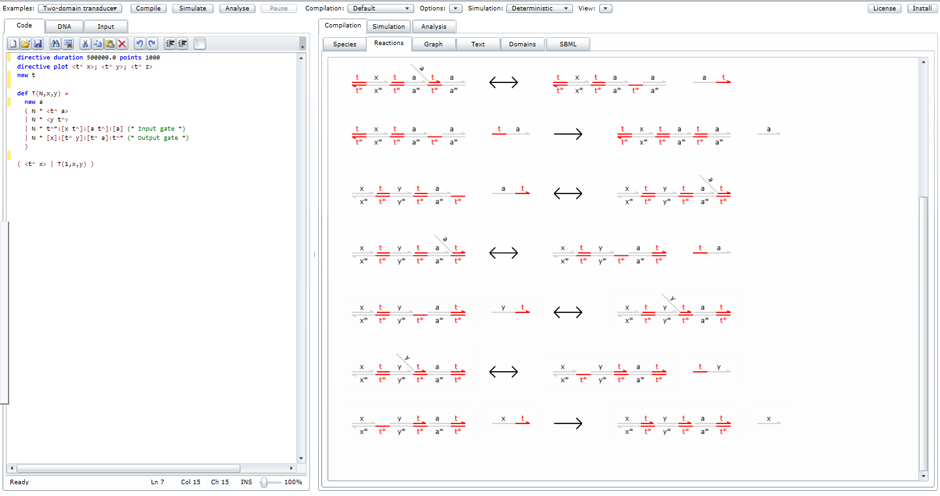
A Development Environment for DNA Gates

Slide 64
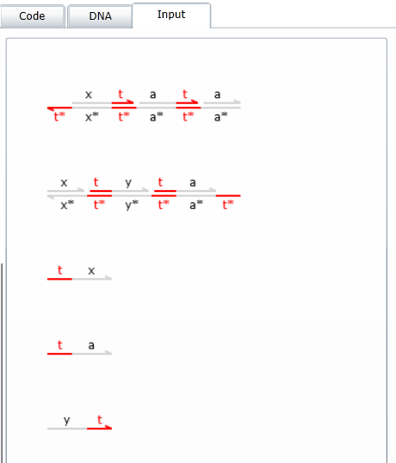
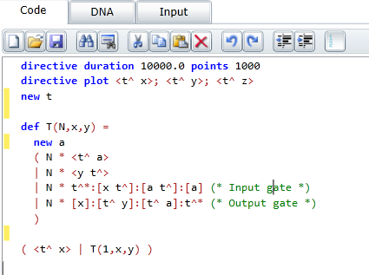
A Language for DNA Structures
Describe the initial structures

Slide 65
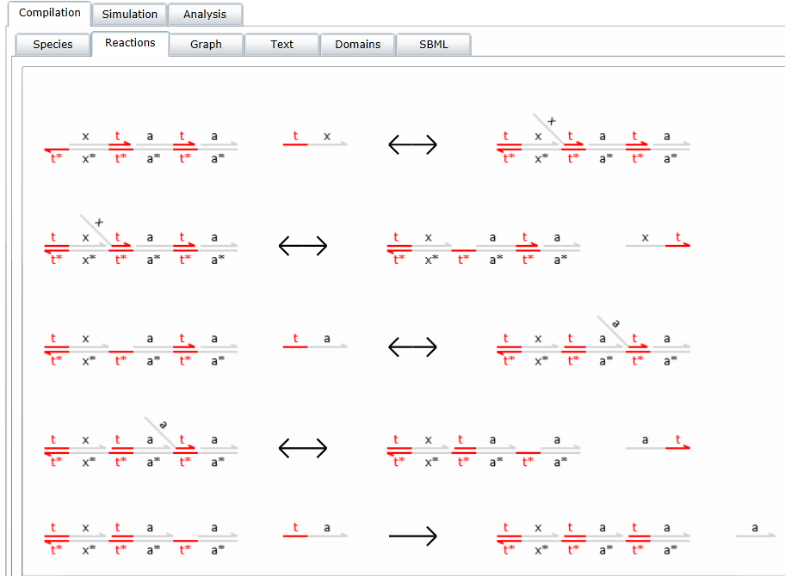
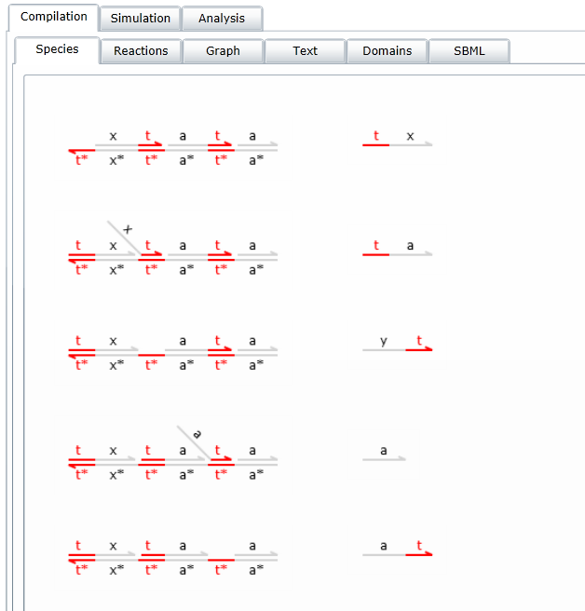
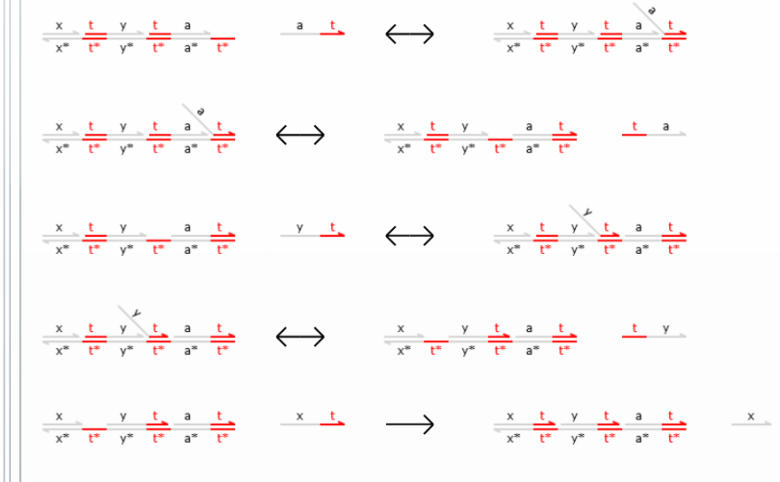
Compute Species and Reactions
Recursively computed from the initial structures

Slide 66
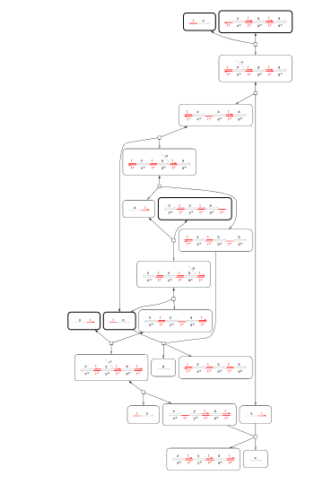
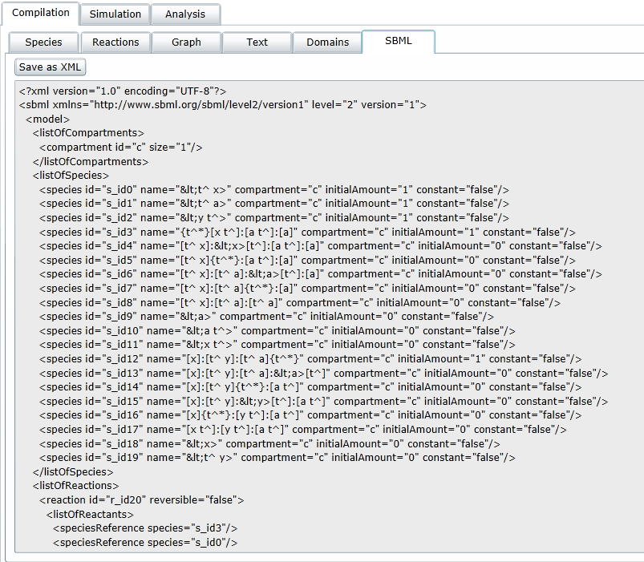
Reaction Graph and Export

Slide 67
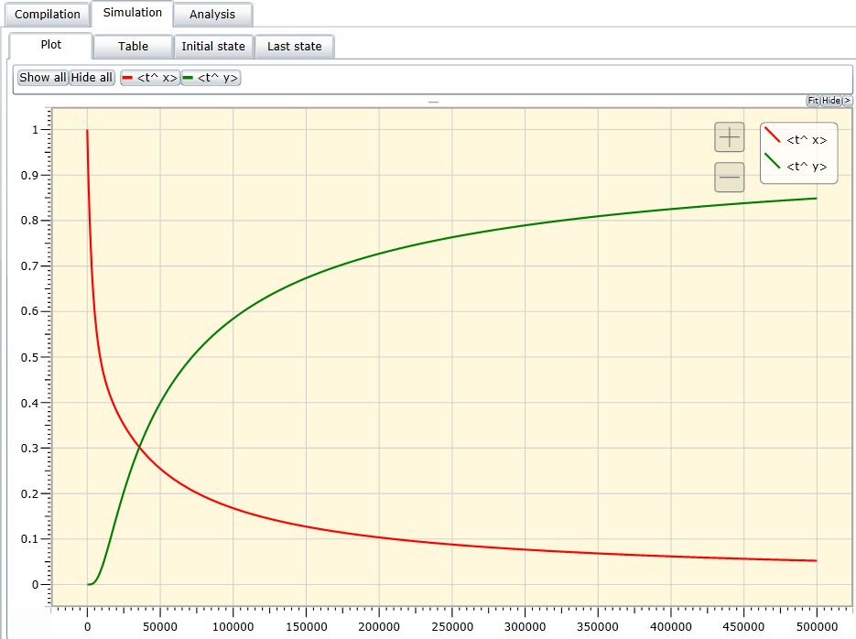
Simulation
Stochastic
Deterministic
“JIT”

Slide 68
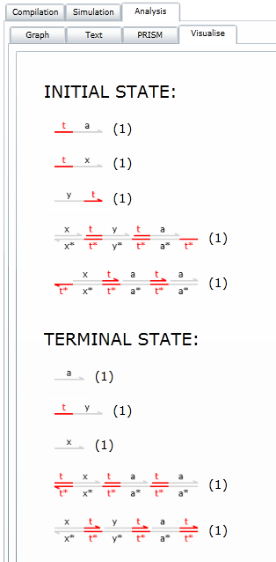
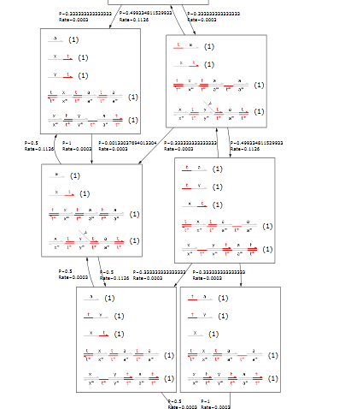
Analysis

Slide 69
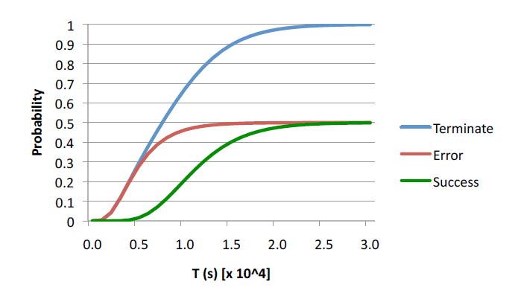
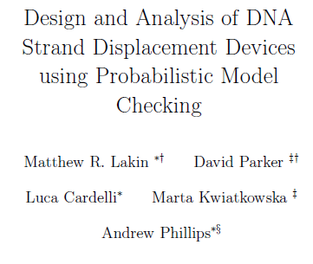
Modelchecking
Export to PRISM probabilistic modelchecker

Slide 70
Tool Output: Domain Structures
Abstract structures
(no DNA sequences)
“Ok, I want to run this for real”

Slide 71
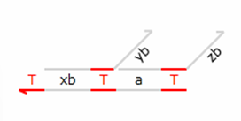
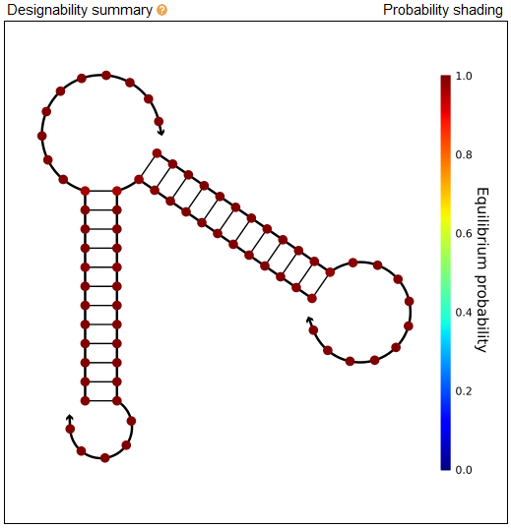
From Structures to Sequences
www.nupack.org
DSD Structure
“Dot-Paren” representation
Output Sequences
Thermodynamic Synthesis
“Ok, where do I buy these”

Slide 72
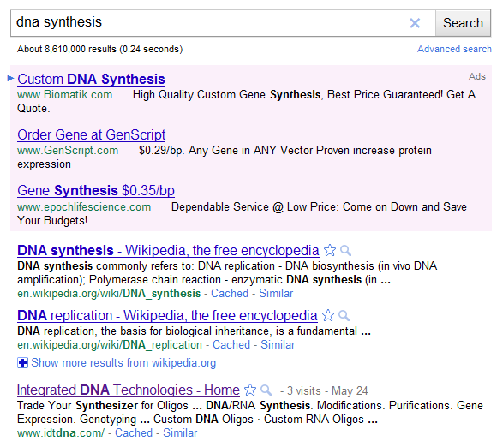
DNA Synthesis

Slide 73
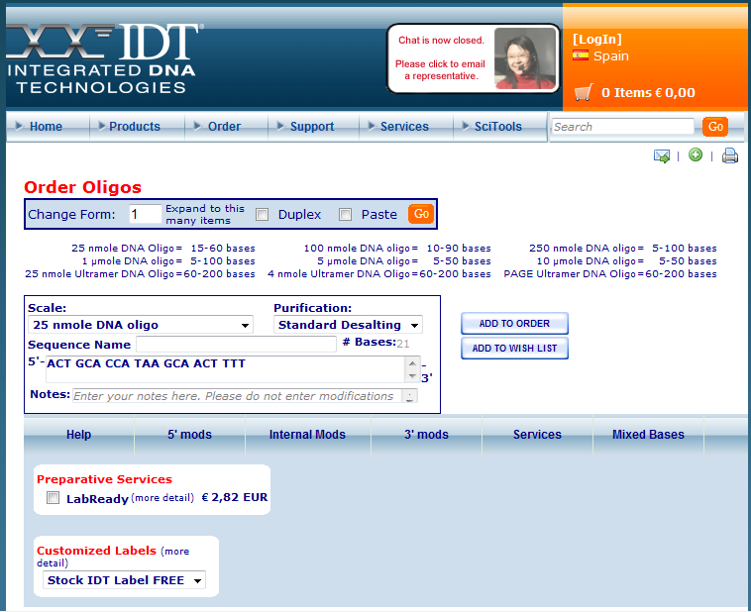
From Sequences to Molecules
Copy&Paste from nupack

Slide 74
Molecules by FedEx
“Ok, how do I run these?”

Slide 75
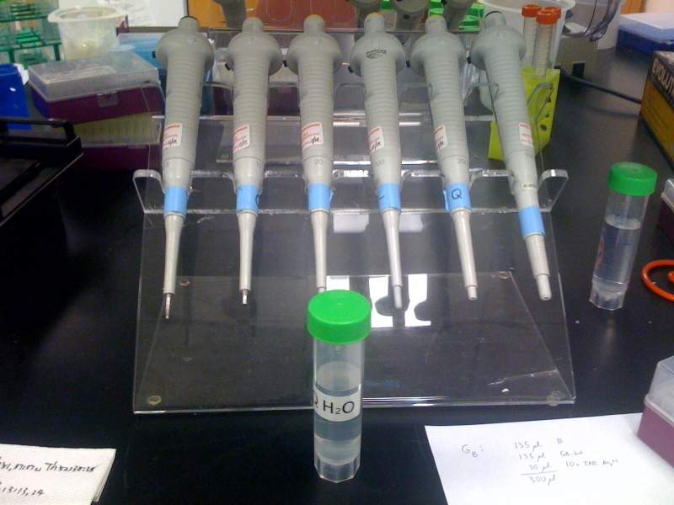
Add Water

Slide 76
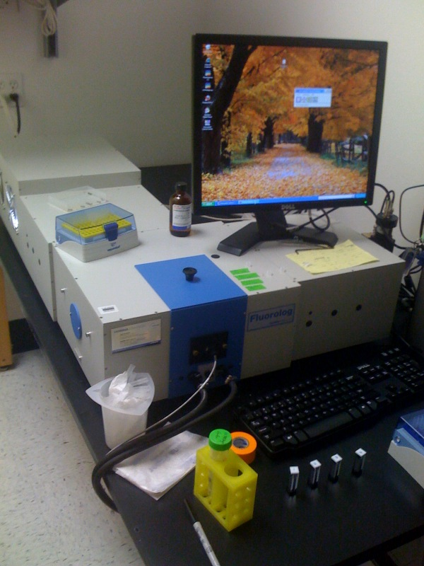
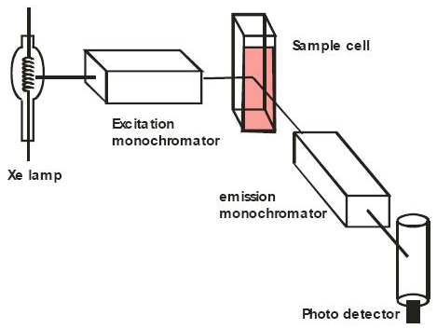
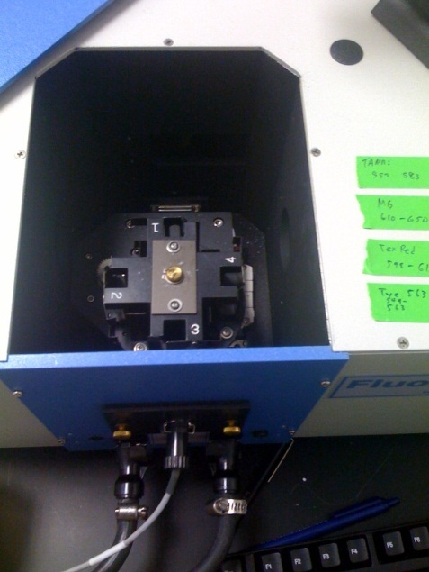
Execute (finally!)
Fluorescence is your one-bit ‘print’ statement
Windows XP!

Slide 77
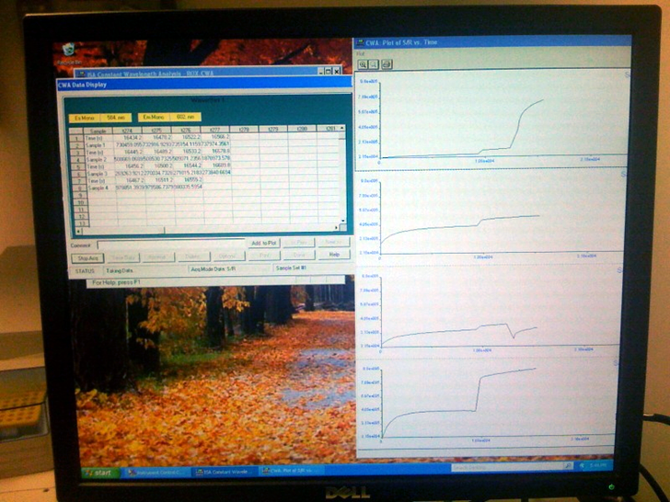
Output

Slide 78
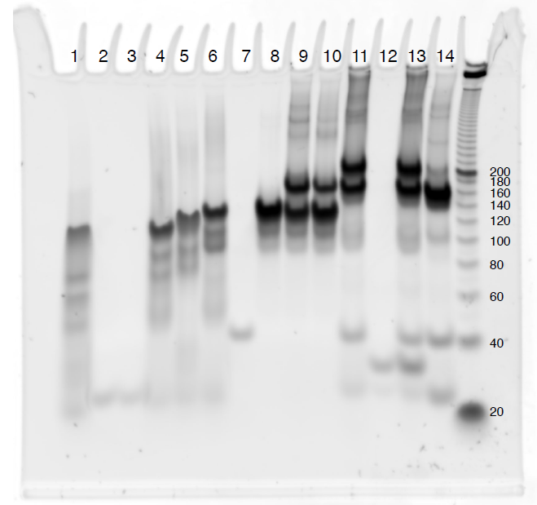
Debugging
A core dump

Slide 79
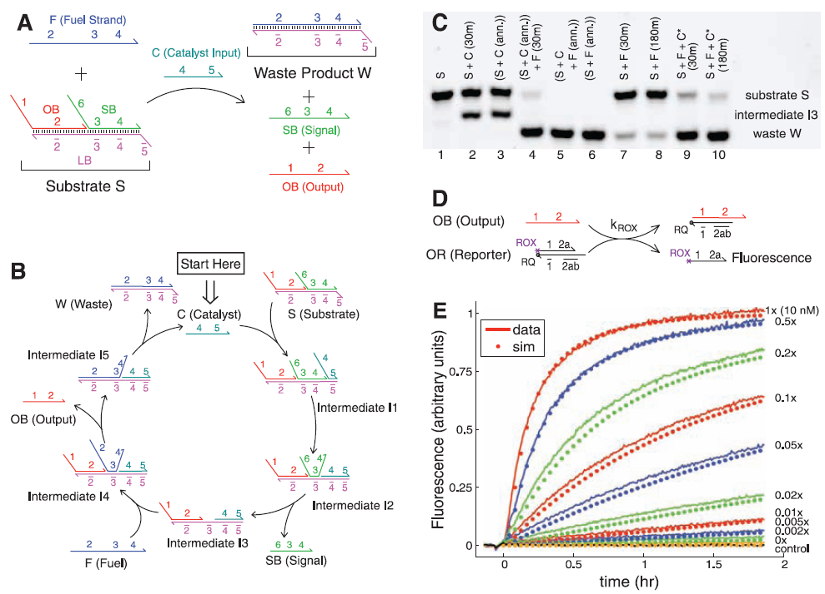
Delivering!

Slide 80
A Molecular Algorithm
Running something interesting with DNA

Slide 81
Approximate Majority Algorithm
Given two populations of agents (or molecules)
Randomly communicating by radio (or by collisions)
Reach an agreement about which population is in majority
By converting all the minority to the majority [Angluin et al., Distributed Computing, 2007]
Could be used to restore a signal to full strength
A chemical implementation
X + Y → B + B
B + X → X + X
B + Y → Y + Y

Slide 82
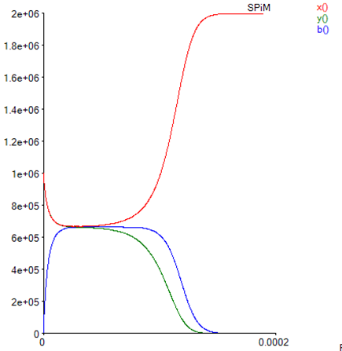
Surprisingly good (in fact, optimal)
Fast: reaches agreement in O(log n) time w.h.p.
O(n log n) communications/collisions
Even when initially #X = #Y! (stochastic symmetry breaking)
Robust: true majority wins w.h.p.
If initial majority exceeds minority by ω(√n log n)
Hence the agreement state is stable
Stochastic simulation of worst-case, with initially #X = #Y

Slide 83
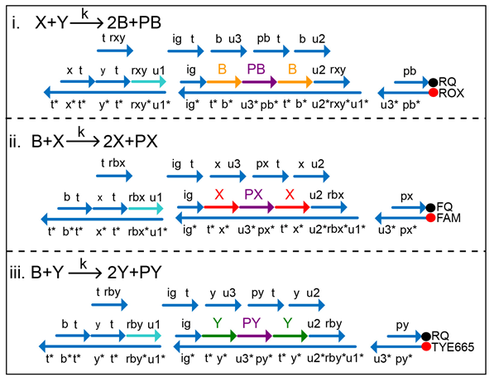
DNA Implementation, at U.W.
A DNA Realization of Chemical Reaction Networks [Yuan-Jyue Chen, Neil Dalchau, Niranjan Srinivas, Andrew Phillips, Luca Cardelli, David Soloveichik and Georg Seelig]

Slide 84
Final Remarks

Slide 85
A Brief History of DNA
Structural DNA Nanotech, 1982
Turing Machine, 1936
DNA, -3,800,000,000
Transistor, 1947
DNA Algorithm, 1994
Software systematic manipulation of information
??
systematic manipulation of matter
Digital Computers
DNA Computers
Computer programming
20th century
Molecular programming
21th century

Slide 86
Acknowledgments
Microsoft Research
Andrew Phillips
Caltech
Winfree Lab
U.Washington
Seelig Lab

Slide 87
Questions?

Slide 88
Resources
Visual DSD at MSR http://research.microsoft.com/apps/pubs/default.aspx?id=157262
Molecular Programming Project at Caltech http://molecular-programming.org/
Georg Seelig’s DNA Nanotech Lab at U.W. CS&E http://homes.cs.washington.edu/~seelig/
This slide deck and related resources: http://lucacardelli.name/Talks/2012-12-06 Molecular Programming (Redmond).pptx
Notes:
<Insert your notes here>
Tips for resources
Name the resource and explain how and why it is useful.
Potential resources include: aliases, articles, books, contacts, online courses, Web sites, and white papers.
Include Web site URLs so that attendees can access resources from printed version of slides.
Example:
Microsoft Manual of Style for Technical Publications (MSTP): The Microsoft corporate style guide http://mstp/
MSTP online course: An introduction to using the MSTP http://mylearning/CourseDetails.aspx?COURSENO=COUR2006070612343804010100
Microsoft Editors Discussion and Information alias (stet): A forum of over 550 content publishers around the company

